Slide 1
Australian Rainfall Prediction
Group 36: Mingxia Tang, Ruoling Fan, Logan Donaldson, Zhiyu Chen
Notes:
Hello everyone , we are in the group 36, and our topic today is forecasting rainfall in Australia.

Slide 2
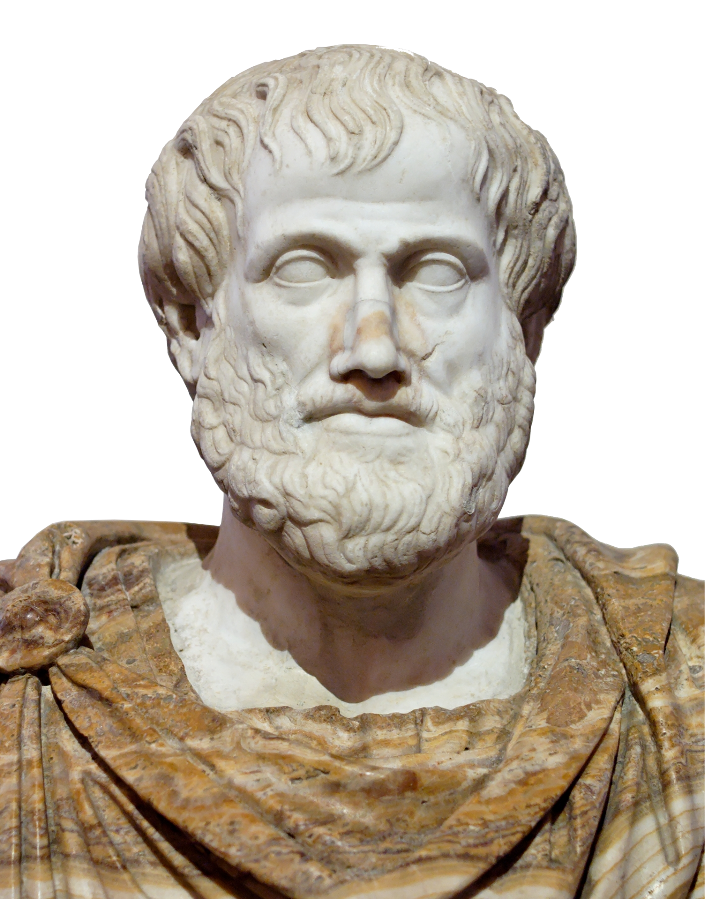

Motivation
Humans have made weather predictions for thousands of years. Babylonians relied on the shape of clouds while Aristotle wrote philosophies about the formation of weather patterns [1]. We take a data-driven approach to solve this age-old problem. Using daily weather data coupled with classification algorithms we predict whether there will be rain on the following day at particular locations in Australia.
Notes:
For thousands of years, humans have been trying to predict the weather using everything from observation to calculation.
Today, we take a data-driven approach to solve this age-old problem. Using daily weather data coupled with classification algorithms we predict whether there will be rain on the following day at particular locations in Australia.

Slide 3
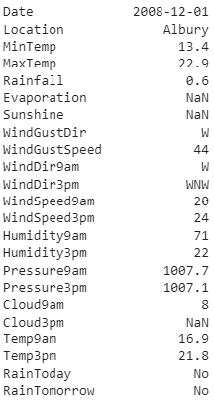
Data Set Description
Daily weather data spanning 2007-2017 from 49 locations in Australia
145,460 rows of data
22 weather related features prior to preprocessing
Original Data Set: Source [2]
Notes:
Our data is from 2007 to 2017, including 49 regions of Australia, and 22 weather-related features.

Slide 4
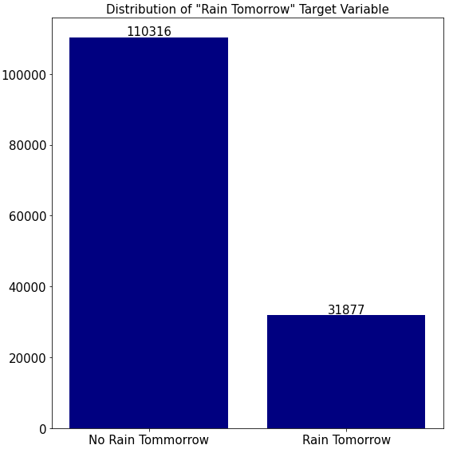
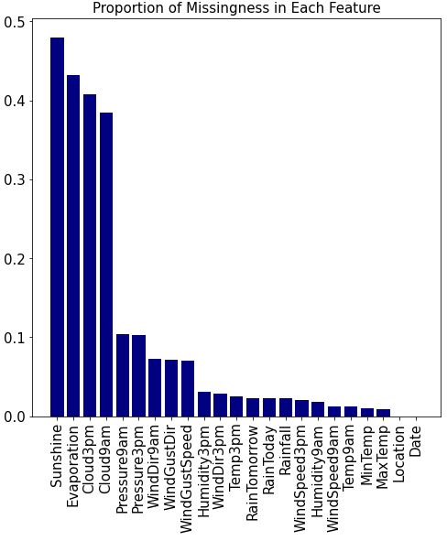
Data Exploration & Challenges
Encoded as 0
Encoded as 1
Notes:
Let's take a brief look at our data set first. We face two major challenges. The first is that the number of days with and without rainfall is very unbalanced. There is no rainfall for more than three-quarters of the days, so it is difficult for us to predict rainfall. The second challenge is that a lot of data is missing, such as sunshine data, half of the data is missing.

Slide 5
Imputation Methodology
x₁₁ x₁₂ . . . . . ? . . . . . x_{1k}
x₂₁ x₂₂ . . . . . . . . . . . x_{2k}
x₃₁ x₃₂ . . ? . . . . . . . . ?
. . .
? . .
. . .
. ? .
. . .
. . ?
. . .
x_{n1} x_{n2} . . . . . . . ? . . . x_{nk}
Iterated Linear Regression Imputation (MICE)
Initialize the (?) with predictions
For each column treat it as the response variable of a linear regression with the other columns as predictors. Use the model to make a new prediction
Repeat step 2 until convergence
Notes:
Since our data set has a times series component we imputed categorical predictors using forward-fill imputation in which missing values are filled with the previous non-missing observation. For continuous features we wanted to leverage our knowledge about non-missing predictors to make more informed decisions about what the missing value should be. To this end we implemented iterated linear regression imputation in which columns with missingness are treated as response variables and other columns are treated as predictors in a linear regression model which is then used to predict the missing values. This is done in a round-robin fashion until the predictions converge.

Slide 6
Random Forest
Label Encoded
Categories
Accuracy
ROC Curve
Set
Parameters
Categorical
Predictors
Preprocess
Dummy Encoded
Categories
Notes:
I’ll tell about Random Forest. This is the structure of my part. After preprocessing, we tried two different ways to deal with categorical variables: label encoded categories and dummy categories. And then chose parameters to make the model perform well. Finally, compare the accuracies and Receiver Operating Characteristic Curves.

Slide 7

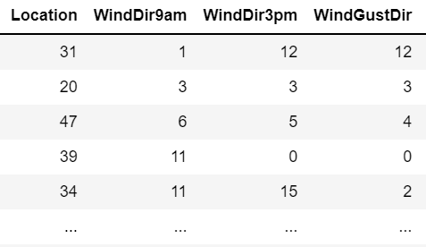
Random Forest
Label Encoded Categories
Each categorical predictor is entered into the model as a single entity so that the model decides how to group or split the values.
Notes:
Here is the first method to process those categorical variables. Since Random Forest can handle categorical variables automatically, we just used LabelEncoder to transform the categorical values to different numerical values. So each categorical predictor can be entered into the model as a single entity so that the model decides how to group or split the values.

Slide 8
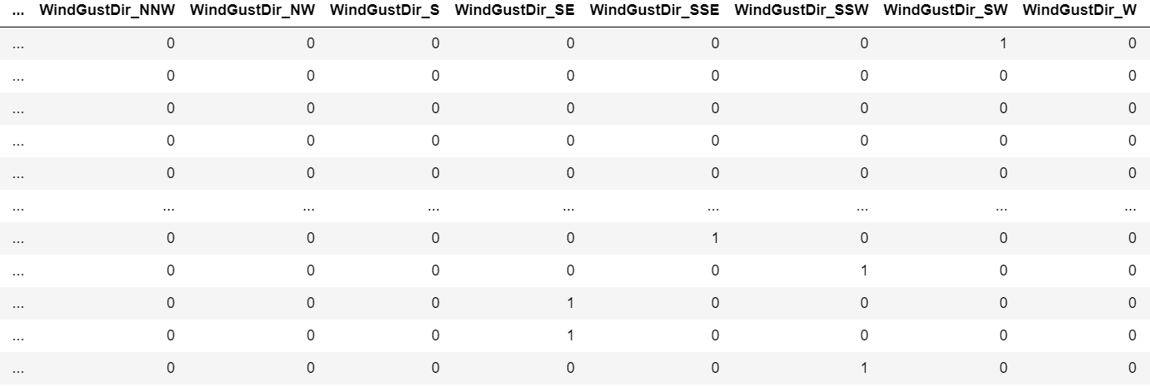
Random Forest
Dummy Encoded Categories
Categorical predictors are first decomposed into binary dummy variables.
Notes:
Another method is that each categorical predictor is decomposed into dummy variables. In this way, the resulting dummy variables are considered independently, forcing two or more splits for the categories.

Slide 9
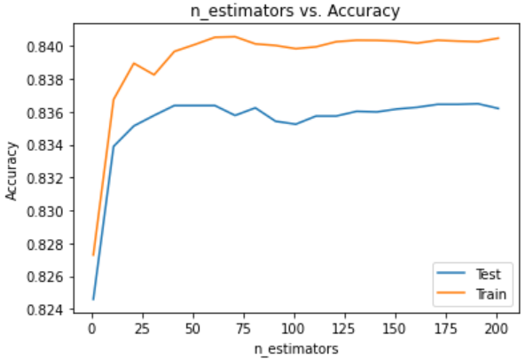
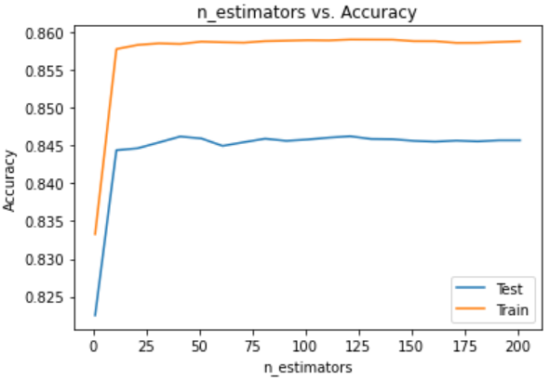
Random Forest
Label Encoded Categories
Dummy Encoded Categories
Best prediction accuracy: 0.8364
n_estimator: 191
Best prediction accuracy: 0.8463
n_estimator: 121
Notes:
During the process of selecting n_estimator, we tried to run a range up to 200. For Label Encoded model, the n_estimator giving the best accuracy is 191, while for Dummy Encoded model, the n_estimator giving the best accuracy is 121.

Slide 10
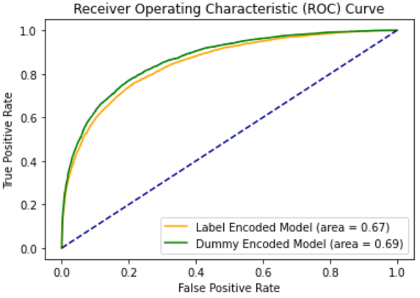
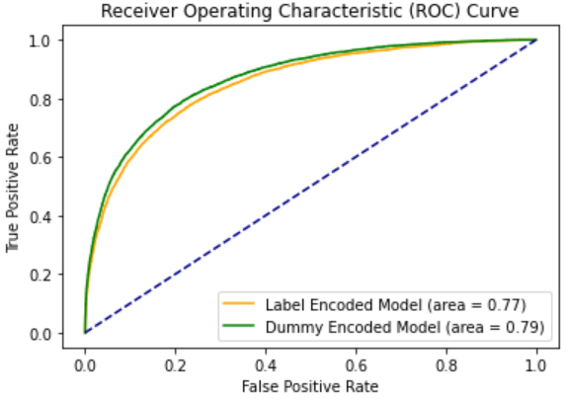
Random Forest
After weighting the
unbalanced data
Notes:
We also compared the ROC curves of these two models. The area under the curve is 67% and 69%, respectively. Considering the original data is unbalanced, as it is mentioned before, we tried to set the class_weight parameter as balanced and plot the ROC curve again correspondingly. We can see from these two figures that after weighting the unbalanced data, the model gives a better ROC curve.

Slide 11
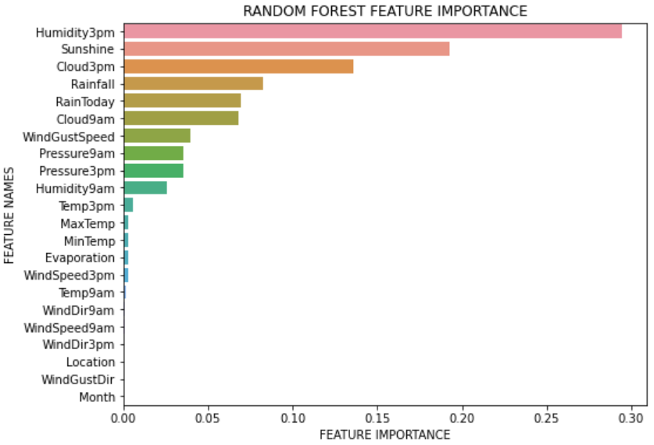
Random Forest
Notes:
After fitting the model, we also did the feature importance. From the figure, we can see the most important features are Humidity and Cloud at 3pm, Cloud at 9am, Sunshine, Rainfall, and whether it rains today.

Slide 12
Support Vector Machines
Original
Dataset
Accuracy
&
Confusion matrix
Different
kernel Functions
Best
C parameter
Scaled
Dataset
(linear,rbf,sigmoid,poly)
Comparison
Notes:
For the support vector machines, we apply the original dataset and scaled dataset, in order to accelerate the speed of model operation, we select 10000 groups of dataset randomly. For the kernel function, we apply four different kernel functions which is linear function, rbf function, sigmoid function and poly function. Then we use cross validated grid search to find the best C parameter for each kernel function. FInally, we calculate the accuracy of each model and draw the confusion matrix.

Slide 13
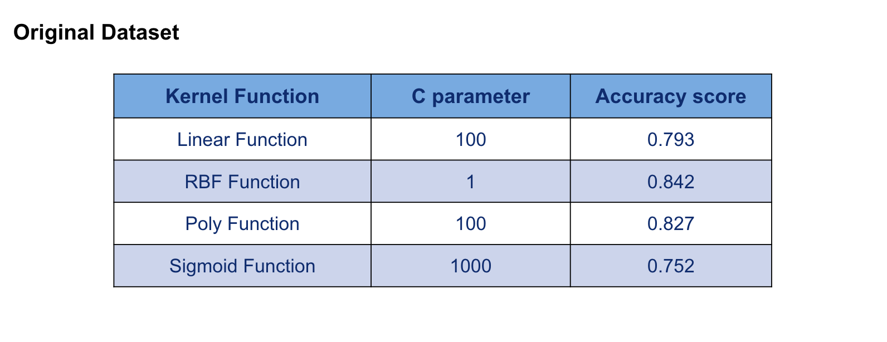
Support Vector Machines
Based on the result, when the kernel function is rbf function with 1 parameter, the svm model can perform best on original dataset.
Notes:
For the support vector machines, we apply the original dataset and scaled dataset, in order to accelerate the speed of model operation, we select 10000 groups of dataset randomly. For the kernel function, we apply four different kernel functions which is linear function, rbf function, sigmoid function and poly function. Then we use cross validated grid search to find the best C parameter for each kernel function. FInally, we calculate the accuracy of each model and draw the confusion matrix.
This results is based on the original dataset. For the four kernel function, the best performance is rbf function with 1 parameter, the accuracy score is 0.842. The worst kernel function is the sigmoid function with 1000 parameter.

Slide 14
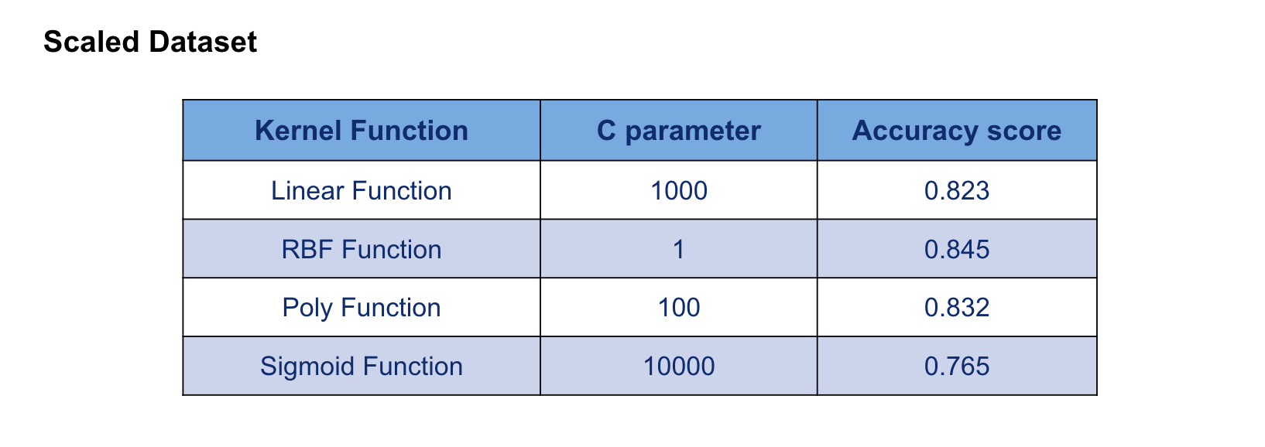
Support Vector Machines
Based on the result, when the kernel function is rbf function with 1 parameter, the svm model can perform best on original dataset.
Notes:
For the scaled dataset, the best performance is still the rbf function. And we can notice that the performance of these four kernel functions with scaled dataset are better than the original dataset.

Slide 15
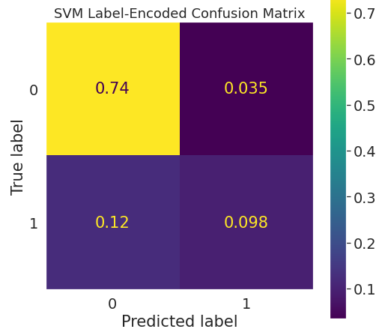
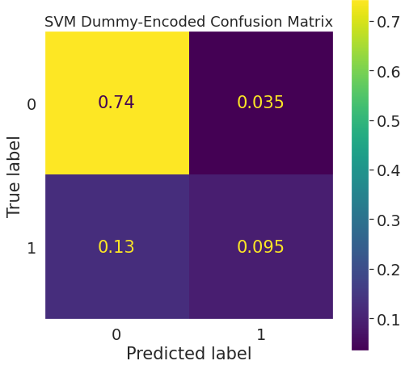
Support Vector Machines
C (Inverse Regularization): 1
Kernel: rbf
C (Inverse Regularization): 1
Kernel: rbf
Accuracy: 0.84
Accuracy: 0.84
Notes:
Then we compared the support vector machines with label-encoded and dummy encoded. It shows that the results are the same.
Both data sets were scaled, centered and had pca applied to reduce features down to the 10 principle components
Trained on subset of 10000 samples, Tested on subset of 4000 testing samples

Slide 16
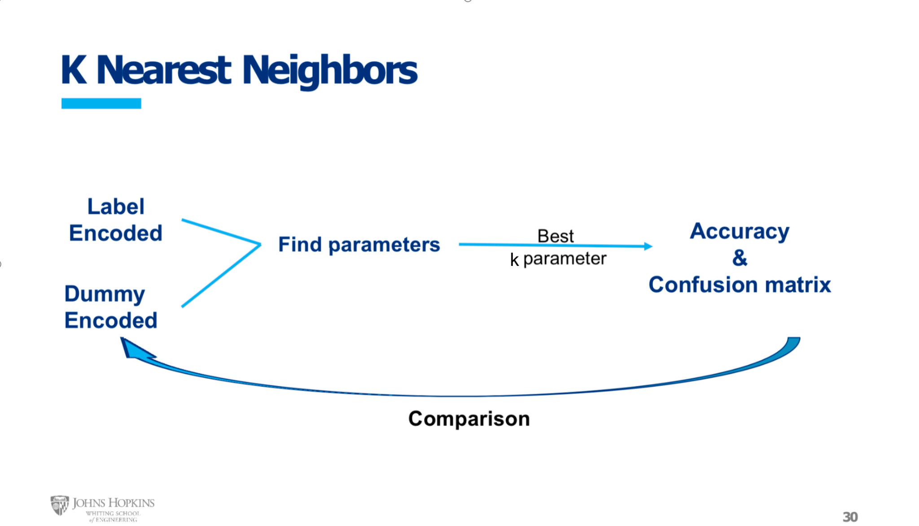
k
Notes:
For the K_nearest Neighbor, we apply two different label methods which is label encoded and the dummy encoded, then we compared the accuracy and draw the confusion matrix.
The dataset we used were scaled, centered and has PCA applied to reduce features down to the 10 principle components. And we train the dataset with 20000 groups data and test the model with 4000 groups dataset.

Slide 17
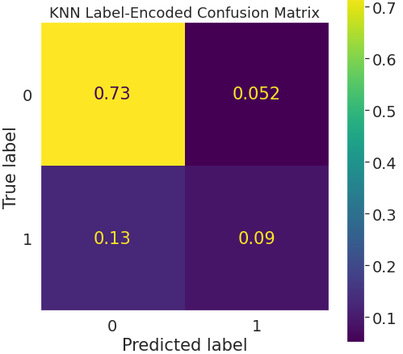
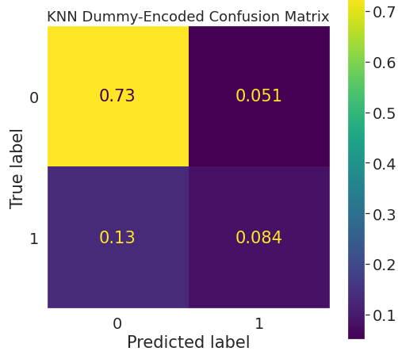
K-Nearest Neighbors
# of Neighbors: 60
Weights: Distance
# of Neighbors: 40
Weights: Distance
Accuracy: 0.82
Accuracy: 0.84
Notes:
For the K_nearest Neighbor, we apply two different label methods which is label encoded and the dummy encoded, then we compared the accuracy and draw the confusion matrix.
The dataset we used were scaled, centered and has PCA applied to reduce features down to the 10 principle components. And we train the dataset with 20000 groups data and test the model with 4000 groups dataset.
We can find for the label_encoded methods the accuracy is 0.82, and the dummy encoded is 0.84. The reason is the dummy variables better capture the relationship between the categorical features and the response.

Slide 18
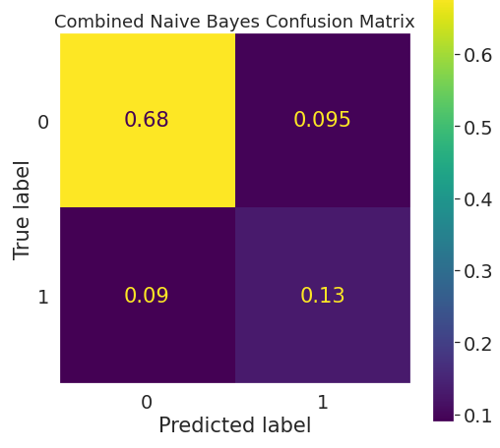
Naive Bayes
Model | Accuracy | F1 score
Gaussian Naive Bayes (Continuous Features) | 0.80 | 0.59
Categorical Naive Bayes (Categorical Features) | 0.79 | 0.33
Combined Naive Bayes (All Features) | 0.82 | 0.59
Notes:
In the Naive Bayes section, we first use our standard Gaussian Naive Bayes on only the continuous predictors. Then we use categorical Naive Bayes which relies on discrete distributions on only the categorical features. Lastly, because Naive Bayes assumes the features are independent, we combine the two approaches by multiplying their output probabilities to form the final combined classifier which performed the best.
At the same time, we use F1 Score to evaluate the model.

Slide 19
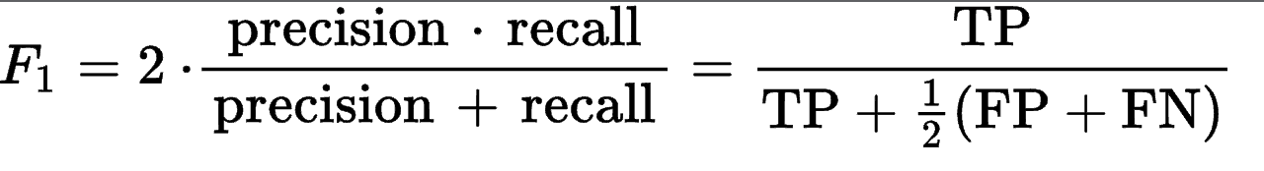
F1 Score
TP = number of true positives
FP = number of false positives
FN = number of false negatives
Notes:
F1 Score is the weighted average of Precision and Recall. Therefore, this score takes both false positives and false negatives into account. Intuitively it is not as easy to understand as accuracy, but F1 is usually more useful than accuracy, especially if you have an uneven class distribution.
Here is the formula for calculating F1 score

Slide 20
Classifier Name
Data Set & Optimal Parameters
ROC - AUC
Accuracy
Logistic Regression | Scaled, centered, dummy-variable encoded data Regularization: l2, Inverse Regularization Strength: .01, Class-Weights: equal | 0.87 | 0.85
LDA | Assumes likelihood is multivariate Gaussian → Only use scaled, centered continuous features | 0.87 | 0.84
QDA | Assumes likelihood is multivariate Gaussian → Only use scaled, centered continuous features | 0.84 | 0.83
Random Forest | Dummy-variable encoded data Class-weight: equal | 0.79 | 0.84
Support Vector Machine | Scaled, centered, dummy-variable encoded data with PCA applied (10 principal components) C (Inverse Regularization): 1, Kernel: rbf | 0.82 | 0.84
K-Nearest Neighbors | Scaled, centered, dummy-variable encoded data with PCA applied (10 principal components) # of neighbors: 40, Weights: distance | 0.86 | 0.84
Naive Bayes | Label encoded data Gaussian distributions git to continuous data Discrete distributions fit to categorical data | 0.75 | 0.82
Notes:
A non-sophisticated classifier that always guess “No Rain Tomorrow” will achieve an accuracy of approximately 78%. This can serve as a baseline to evaluate our results. We note that from these 7 classifiers logistic regression performed marginally better than the rest. Also, we observe that Naive Bayes performed the worst likely because the assumptions about the features being independent and normally distributed did not hold.

Slide 21
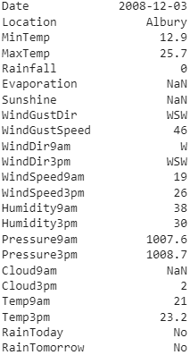
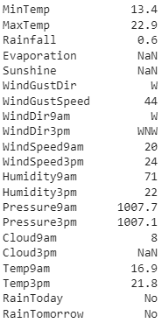
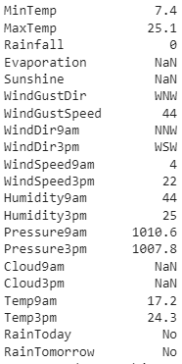
Neural Network Input Data & Hyperparameters
Third Data Point
First Data Point
Second Data Point
Altered rows to contain 2-day lag features
Training Set: Data from 2007/11/01 — 2015/06/15
Test Set: Data from
2015/06/15 — 2017/06/25
Epochs: 50
Batch Size: 40
Learning Rate: 0.001
Optimizer: Stochastic Gradient Descent
Loss Function: Binary Cross Entropy
Notes:
We also built a simple Feed-Forward Neural Network. Since the data set has a time series component we added 2-day lag features to each data point, nearly tripling the number of features. The training set consisted of data from 2007 to 2015 while the testing set contained data from 2015-2017. We trained for 50 epochs using a batch size of 40, a learning rate of .001, stochastic gradient descent, and binary cross entropy loss.

Slide 22
Network Architecture
Probability of Rain the Next Day
Sigmoid Function
Hidden Layer,
size = 123
Input Features,
size = 245
ReLU Activation Function
Batch Normalization
Dropout, p=0.1
Code Adapted From: Source [3]
Notes:
Our network consists of only a single hidden layer with 123 hidden nodes. A ReLU activation function is applied to each node and during training we implemented mild dropout, to reduce overfitting, and batch normalization, to speed up the gradient descent. Lastly, to obtain our prediction, we apply the sigmoid function.

Slide 23
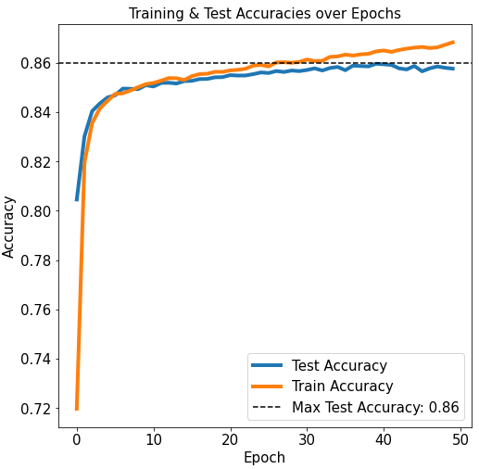
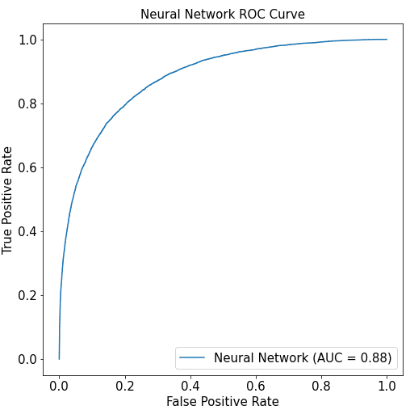
Network Metrics
Notes:
We see that the Neural Network slightly outperformed the other models with an accuracy of 86% and an area under the curve of 0.88. An interesting thing to note is that for the first few epochs training accuracy was less than test accuracy. Possible reasons for this include the test set (2015-2017) being “easier” to predict than the training set (2007-2015) and the training predictions being made with only a subset of the nodes due to dropout.

Slide 24
Conclusions
Every classifier was able to outperform the baseline suggesting (78% accuracy) suggesting that our features do influence the response
Though the neural network performed marginally better all classifiers achieved approximately the same accuracy once their parameters were optimized
We may be able to achieve better accuracy by using the Synthetic Minority Oversampling Technique (SMOTE) to artificially generate more sample points belonging to the “Rain Tomorrow” class
As a future direction we could investigate how well our models generalize to predicting next day rain in other time frames and locations

Slide 25
References
[1] NASA. (2002, February 25). Weather Forecasting Through the Ages. NASA Earth Observatory. Retrieved December 19, 2021, from https://earthobservatory.nasa.gov/features/WxForecasting/wx2.php
[2] Young, J., & Young, A. (2020, December 11). Rain in Australia. Kaggle. Retrieved October 23, 2021, from https://www.kaggle.com/jsphyg/weather-dataset-rattle-package
[3] Verma, A. (2021, October 27). Pytorch [Tabular] - Binary Classification. Towards Data Science. Retrieved December 17, 2021, from https://towardsdatascience.com/pytorch-tabular-binary-classification-a0368da5bb89

Slide 27
Individual Contributions
Mingxia Tang: Random Forest
Ruoling Fan: Support vector machines, K nearest neighbors，Conclusions
Zhiyu Chen: Finding dataset, Introduction part, Naive Bayes Model
Logan Donaldson: Initially cleaned data, imputed data, logistic regression, linear discriminant analysis, quadratic discriminant analysis, neural network

